Slide 1
HEDIS/CAHPS
Quality Improvement
Medical Care Advisory Committee (MCAC)
Rachel Vasquez, Quality Program Manager

Slide 2
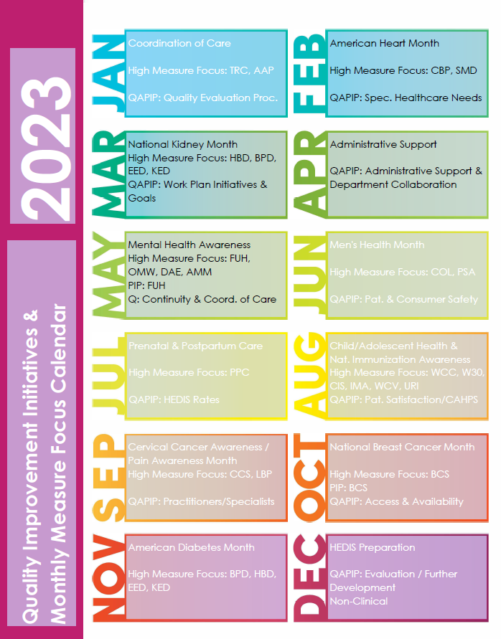
Monthly measure Focus program
Plan, Do, Study, Act (PDSA) Methodology is utilized to determine incentives/initiatives needed for individual measures for greater focus within the Quality teams Monthly Measure Focus Program.

Slide 3
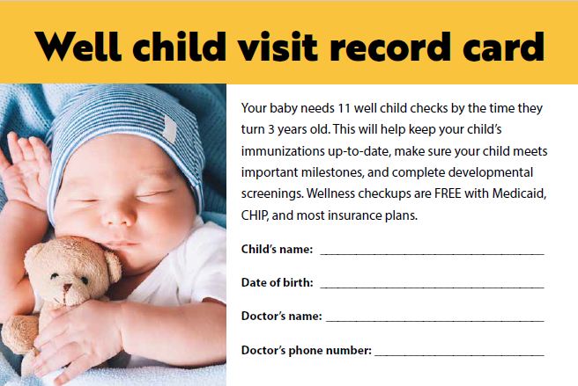
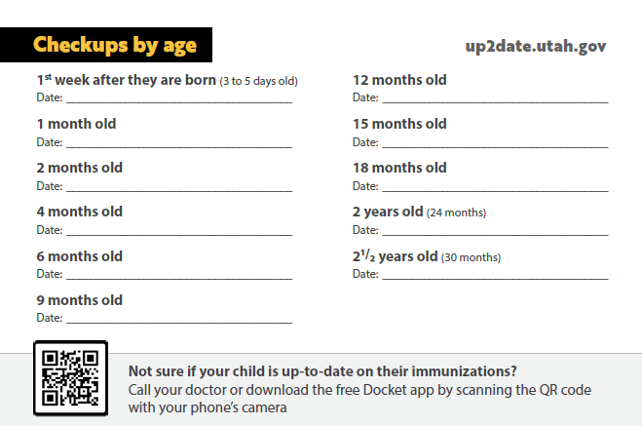
Child & Adolescent Measures
Childhood Immunization Status (CIS)
Telephonic Member Outreach
Provider Office Care Gap Reports
Member Newsletter Articles on Immunizations and Importance
Immunizations for Adolescents (IMA)
Telephonic Member Outreach
Provider Office Care Gap Reports
$25 Member Incentive upon Completion of Combo 3 Series
Well Child Visits (W30) 0-15 Months & 15-30 Months
Telephonic Member Outreach
Provider Office Care Gap Reports
Members - Well Child Visit Educational Letter and Schedule with Appointment Tracking (Mailed out early August 2023)
Providers – Communicated link where cards can be accessed/printed
Well Child Visit Schedule Fridge Magnet for New Member Packets (Coming soon)
Well Care Visits Ages 3-21 (WCV)
Telephonic Member Outreach
Provider Office Care Gap Reports
Member Reminder Postcards for ages 3-17 & 18-21

Slide 4
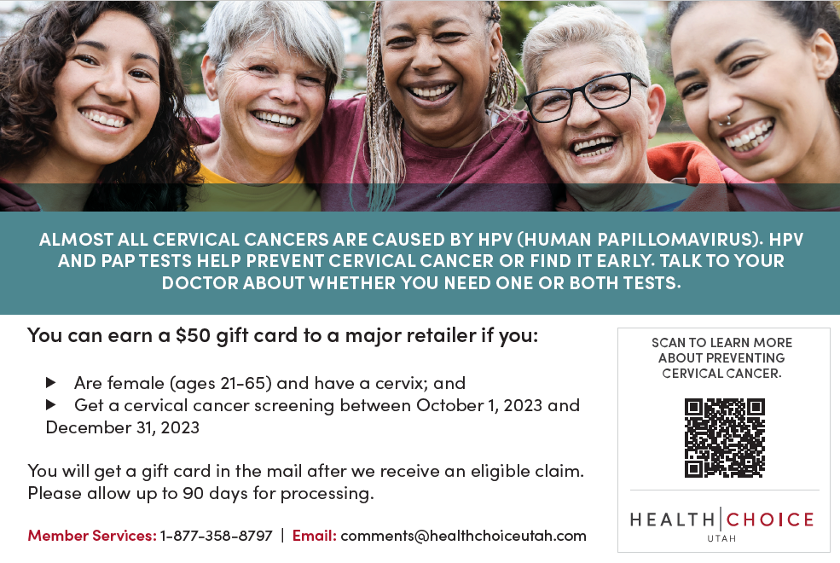
Cancer Screenings
Breast Cancer Screening (BCS)
Member IVR Campaign with warm transfers to schedule mammogram
Provider Office Care Gap Reports
$50 Member Incentive
Cervical Cancer Screening (CCS)
Member IVR Campaign with warm transfers to Member Services to help find provider, if needed
Provider Office Care Gap Reports
$50 Member Incentive

Slide 5
Adult Measures
Adult Access to Preventive/Ambulatory Health Services (AAP)
IVR Campaign early November 2023
Outreach for Members Unattributed to a PCP
Provider Office Member Outreach Campaigns
Eye Exams for Patients with Diabetes (EED)
Telephonic Member Outreach
Provider Office Care Gap Reports
$25 Member Incentive
Vendor diabetic application program
* Provider Group value-based reimbursement models are under continued development, with the first in place and additional groups to follow in the new year.

Slide 6
UMIC Follow-up Measures
Follow-up After Emergency Department Visit for Mental Illness (FUM)
Follow-up After Emergency Department Visit for Alcohol and Other Drug Abuse or Dependence (FUA)
Follow-up After Hospitalization for Mental Illness (FUH)
Barriers:
Health plans are notified of a member being seen in an Emergency Department (ED) when a claim is received, which can happen 30 days or more after the member discharges. With measure stratifications of 7 and 30 day follow-up timeframes, this is not timely enough for follow-up activities. HCU receives Admit, Discharge, Transfer (ADT) Alerts from the Clinical Health Information Exchange (CHIE), however, the data may not include complete accounts for reason of admit, etc.
Quality Improvement:
HCU’s Clinical Operations team includes coordinators who actively monitor ADT Alerts and notify Care Management if criteria is met, indicating a member needs follow-up pertaining to one of the above measures. A Care Manager will attempt to contact the member to conduct a behavioral health questionnaire and help connect them with a mental health specialist for a follow-up appointment.
For members hospitalized for a mental illness, our Utilization Management team notifies Care Management of admission, and contact is made with hospital social workers/care managers to collaborate on solid and safe discharge planning to include an appointment for follow-up within 7 days.
HCU’s Quality and Provider Network teams conduct quarterly meetings with community based providers to connect on any known issues and ensure appointments are able to be scheduled in the appropriate timeframes.

Slide 7
CAHPS Measures
Customer Service
How Well Doctors Communicate
Getting Care Quickly
Getting Needed Care
An important consideration for CAHPS measures is response rates and usable surveys, as low response rates should be interpreted with caution. Response rates for HCU’s CAHPS samples are as follows:
ACO Child Survey – 12.1%
ACO Adult Survey – 11.7%
UMIC Adult Survey – 7.1%
The majority of HCU’s CAHPS rates improved from the prior year ratings.
How well doctors communicate appears to be the common rate decrease. HCU Quality staff meet monthly with provider offices and will increase education and sensitivity on discussions around clear methods of communicating with members to ensure understanding and a formation of trust within the healthcare community can be reached.

